Slide 1

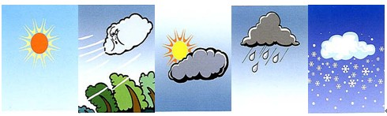
Oxford English
Module 4 The world around us
12
Weather
Period 2
执教者：
深圳市向南小学 冯慧曦

Slide 2

Let’s review!
What can you see?
How’s the weather?

Slide 3
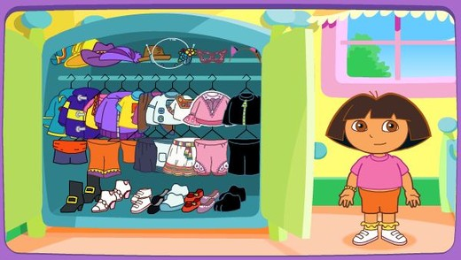
Let’s help!
wear
head
bread
What to wear（穿）?

Slide 4


Slide 5


Slide 6


Slide 7

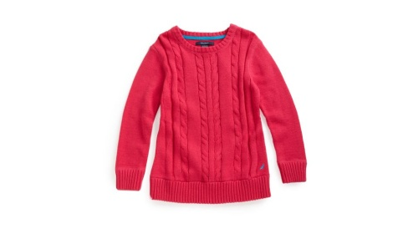
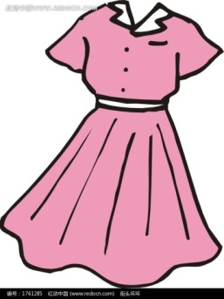


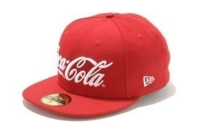
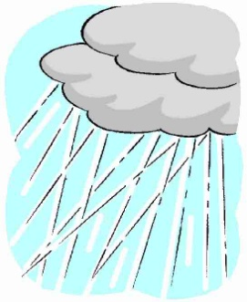
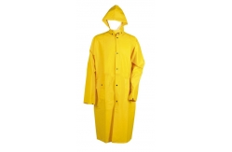
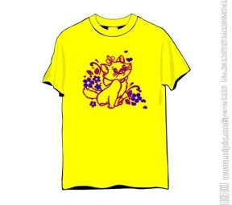
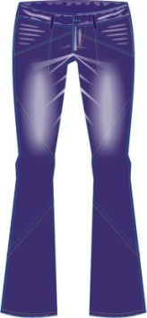


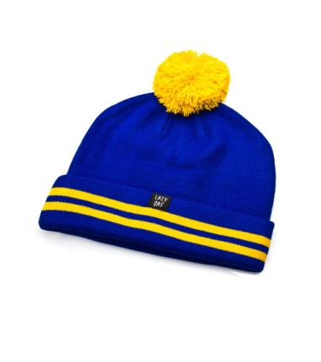
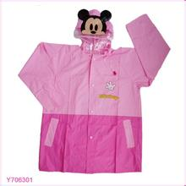
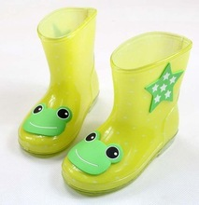
Brain storm
Different weather, we wear different clothes.
It’s , I wear a .
It’s , I wear a .
It’s , I wear a .

Slide 8
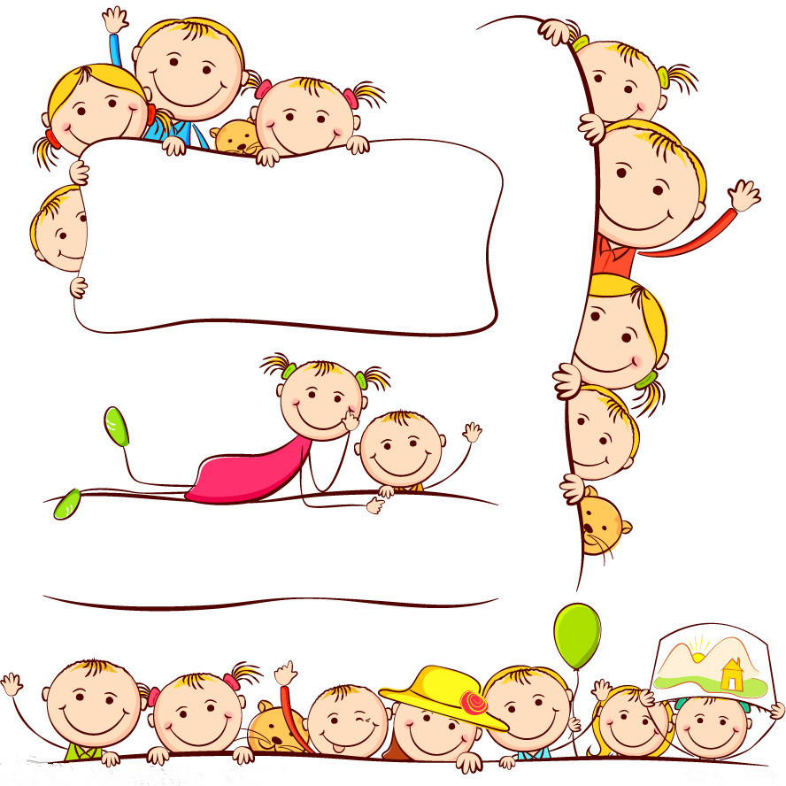
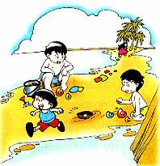
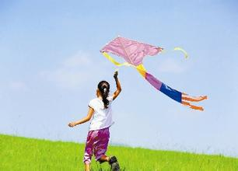
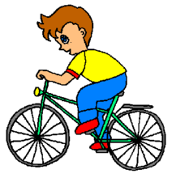
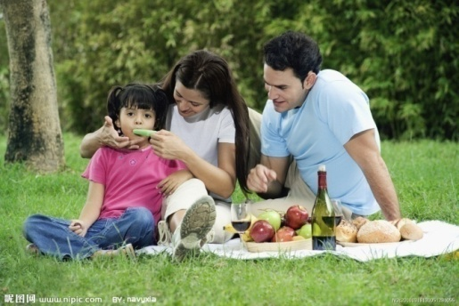

Think and say
Different weather, different feelings.
What kind of weather do you like?
What can you do?
What kind of weather don’t you like?
What can’t you do?
I like … days.
I can…
I don’t like … days.
I can’t…

Slide 9


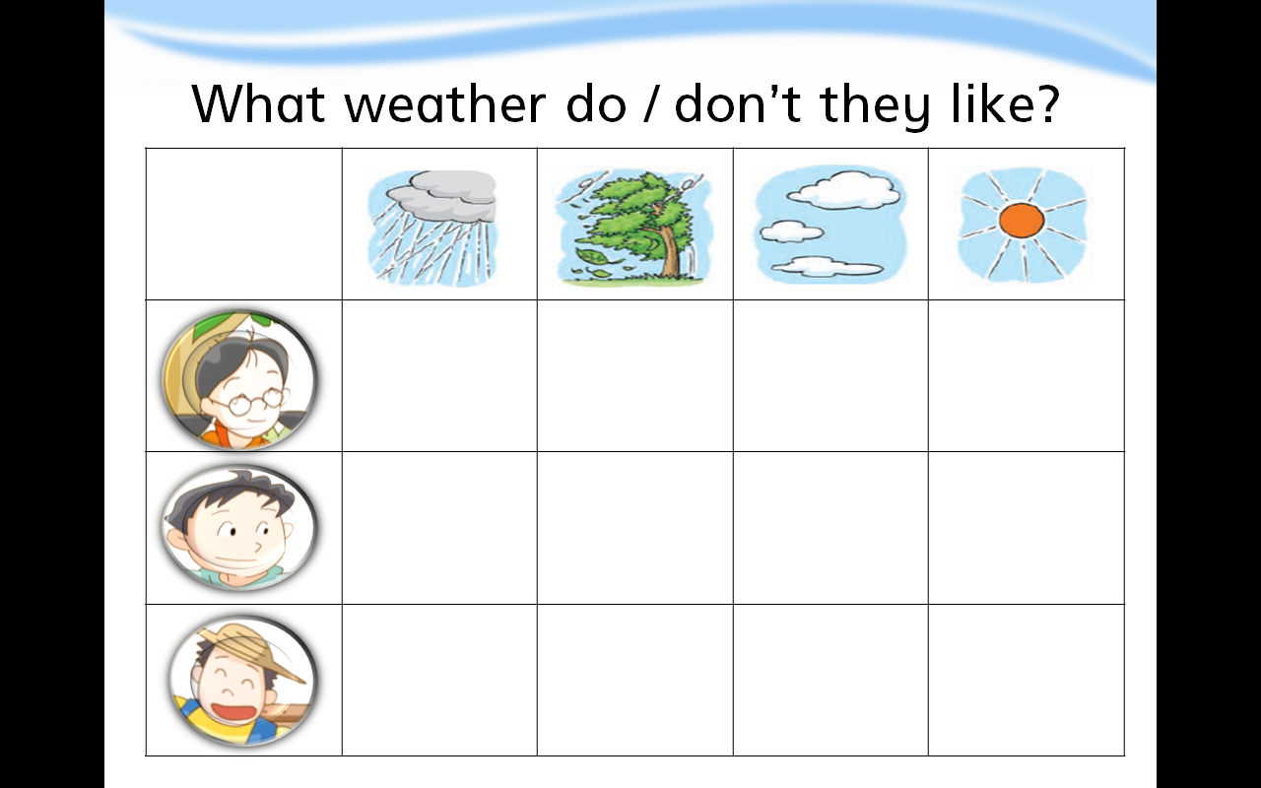
Listen and draw
What weather do they like?
What weather don’t they like?
Kitty
Dad
Farmer
Notes:
While-task procedure 1:
活动内容: Listen and draw
活动目的：初听课文，了解不同人物在不同天气状况下的不同心情，掌握不同表达。
操作方法：播放课文动画，完成练习。

Slide 10
Say and act

Slide 11

Listen and draw
What weather do they like?
What weather don’t they like?
Kitty
Dad
Farmer

Slide 12
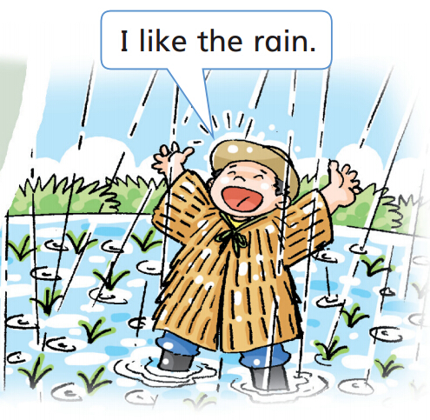
Think and answer
Does the farmer like the rain? Why?
I like the rain.
It can help my plants grow(生长）!
The farmer likes the rain.
Because it can help his plants grow.

Slide 13
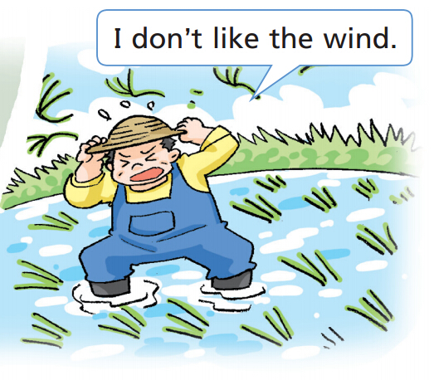
Think and answer
Does the farmer like the wind? Why?
I don’t like the wind.
It can blow down my plants.
The farmer doesn’t like the wind.
Because it can blow down the plants.

Slide 14
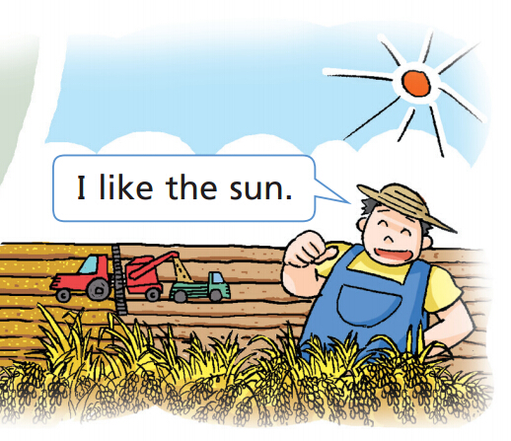
Think and answer
Does the farmer like the sun? Why?
I like the sun.
It can make my plants strong!
The farmer likes the sun.
Because it can make his plants strong.

Slide 15
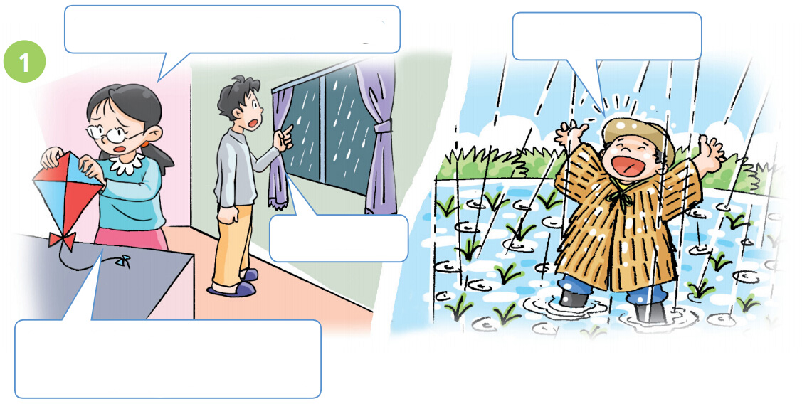
Say and act
How’s the weather today?
I like the rain.
It’s rainy.
I don’t like the rain. I can’t play in the park.
Notes:
I like the rain. Read happily.

Slide 16
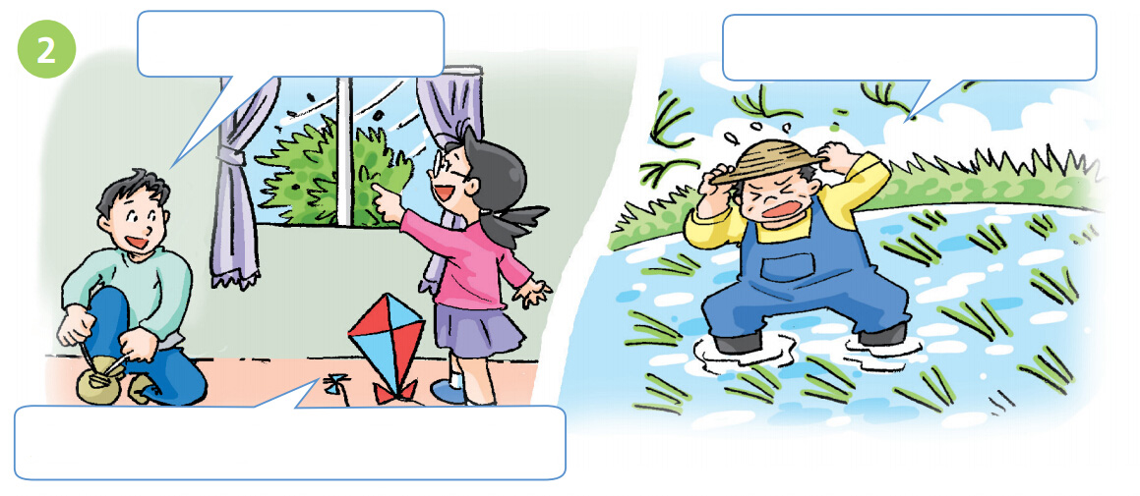
Say and act
It’s windy today.
I don’t like the wind.
I like the wind. I can fly my kite.

Slide 17
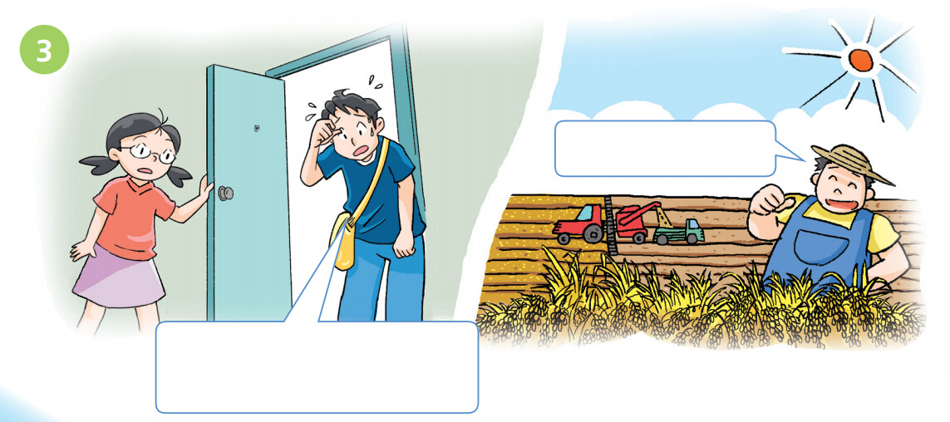
Say and act
I like the sun.
It’s hot today. I don’t like the sun.

Slide 18
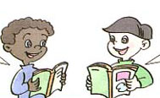



Role reading

Slide 19
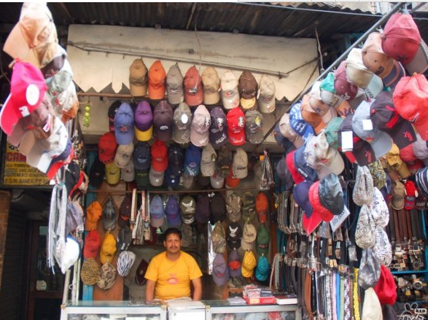
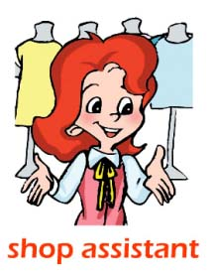
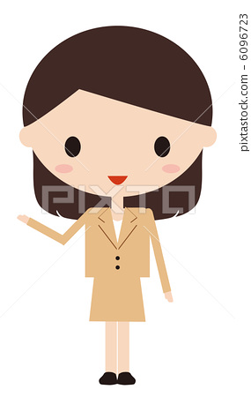
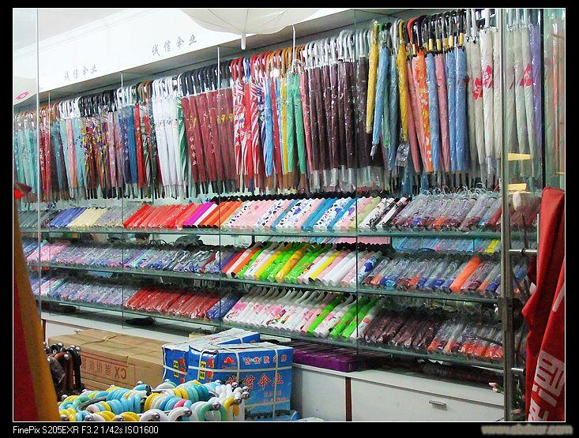
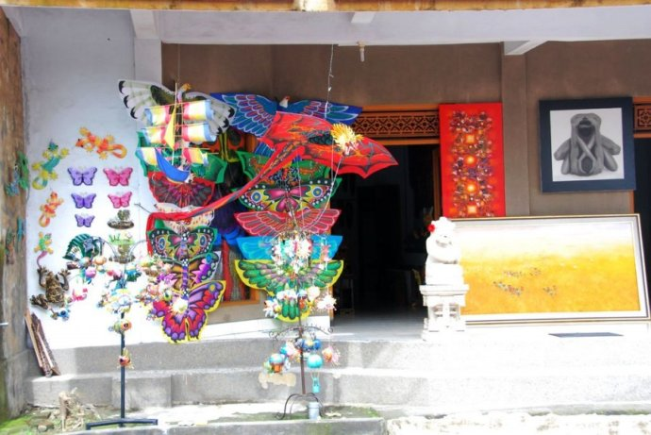
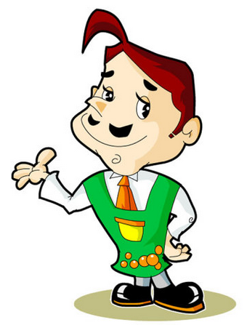
What weather do they like? What weather don’t they like?
Different people,
different feelings.
The cap shop
The umbrella shop
The kite shop

Slide 20

I like sunny days. I can sell(卖） my caps.

Slide 21
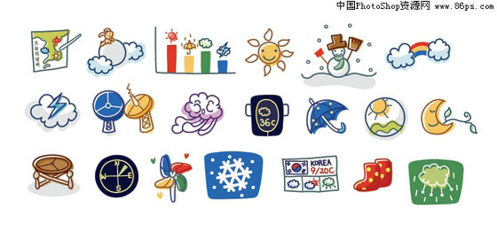
Let’s chant
It’s windy.
It’s windy outside.
Go to the park and fly a kite.
It’s ______.
It’s ______ outside.
________and________.

Slide 22
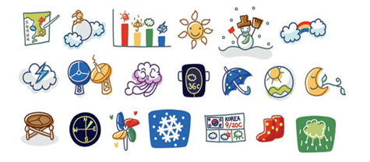
Talk about your favorite weather
I like windy days.
I can see the wind.
It’s cool. It’s nice.
I wear（穿） a jacket on windy days.
I can go to the park and fly a kite.
I don’t like rainy days.
I can’t play outside on rainy days.
I like ...
I can see the ...
It’s ...
I wear（穿） ...
I can ...
I don’t like ...
I can’t ...

Slide 23
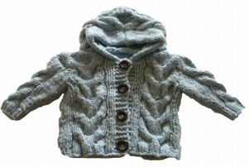
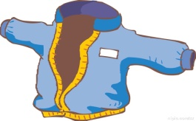
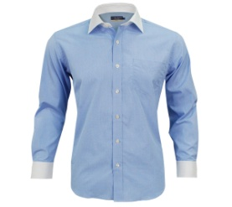


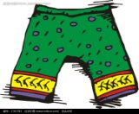

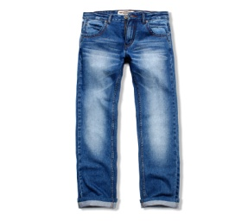
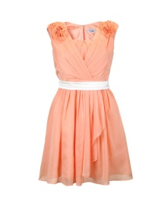

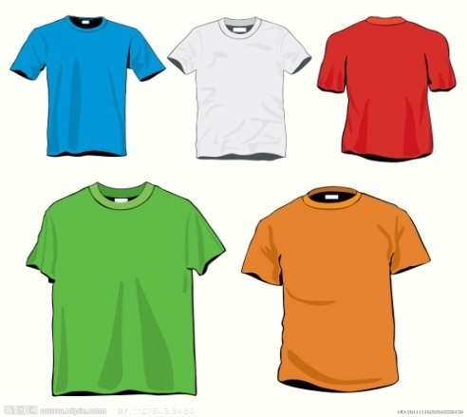

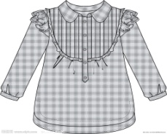
Review

Slide 24
Homework
Listen to and read the text on Student’s Book page 60.
Talk about your favorite weather.

Slide 25


